Slide 1
Data Wrangling
Lab 3
“Data scientists, according to interviews and expert estimates, spend from 50 percent to 80 percent of their time mired in the mundane labor of collecting and preparing data, before it can be explored for useful information.”
- New York Times 2016

Slide 2
Agenda
Common problems in data wrangling – table contents and formatting
Long, wide, and unusual data formats
Thoughts on the tidyverse, tidy data
Computer memory and “big” data
Indexing, logical indexing in base R
Factor/categorical variables

Slide 3
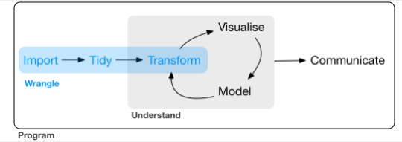
The data analysis pipeline
Hadley Wickham’s R for Data Science (mostly tidyverse)

Slide 4
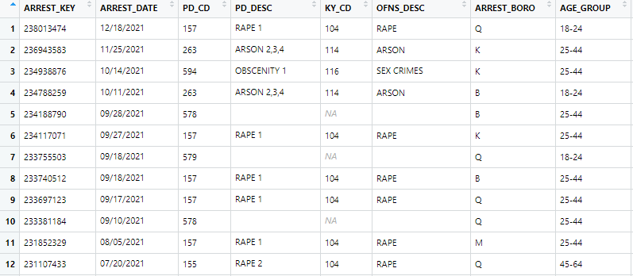
Any issues with this data frame?

Slide 5

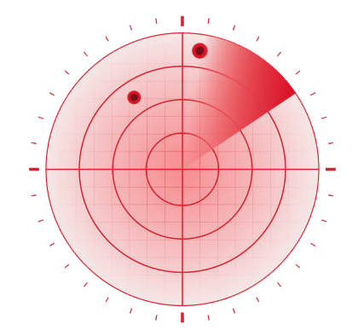
Key tools for navigating datasets
Plotting “on-the-fly”
Logical queries
Error messages

Slide 6
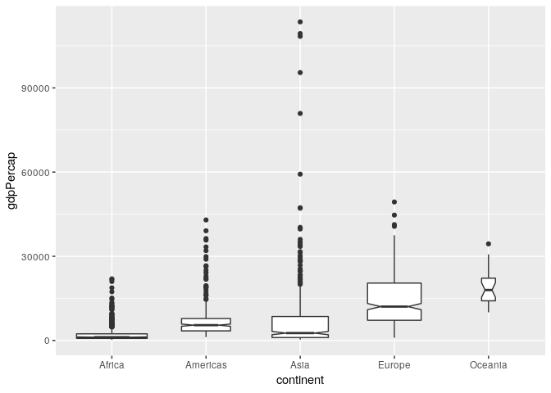
Anything wrong with this plot?
Notes:
Simple plotting as a means of inspecting the dataset

Slide 7
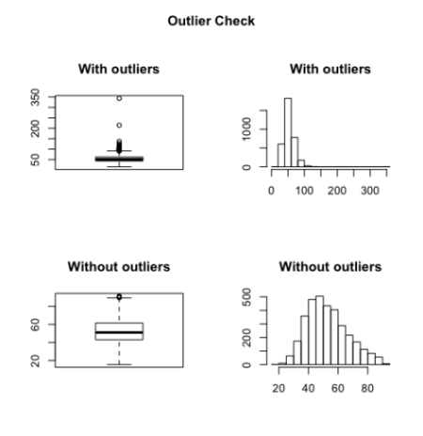
Outliers – what to do?

Slide 8
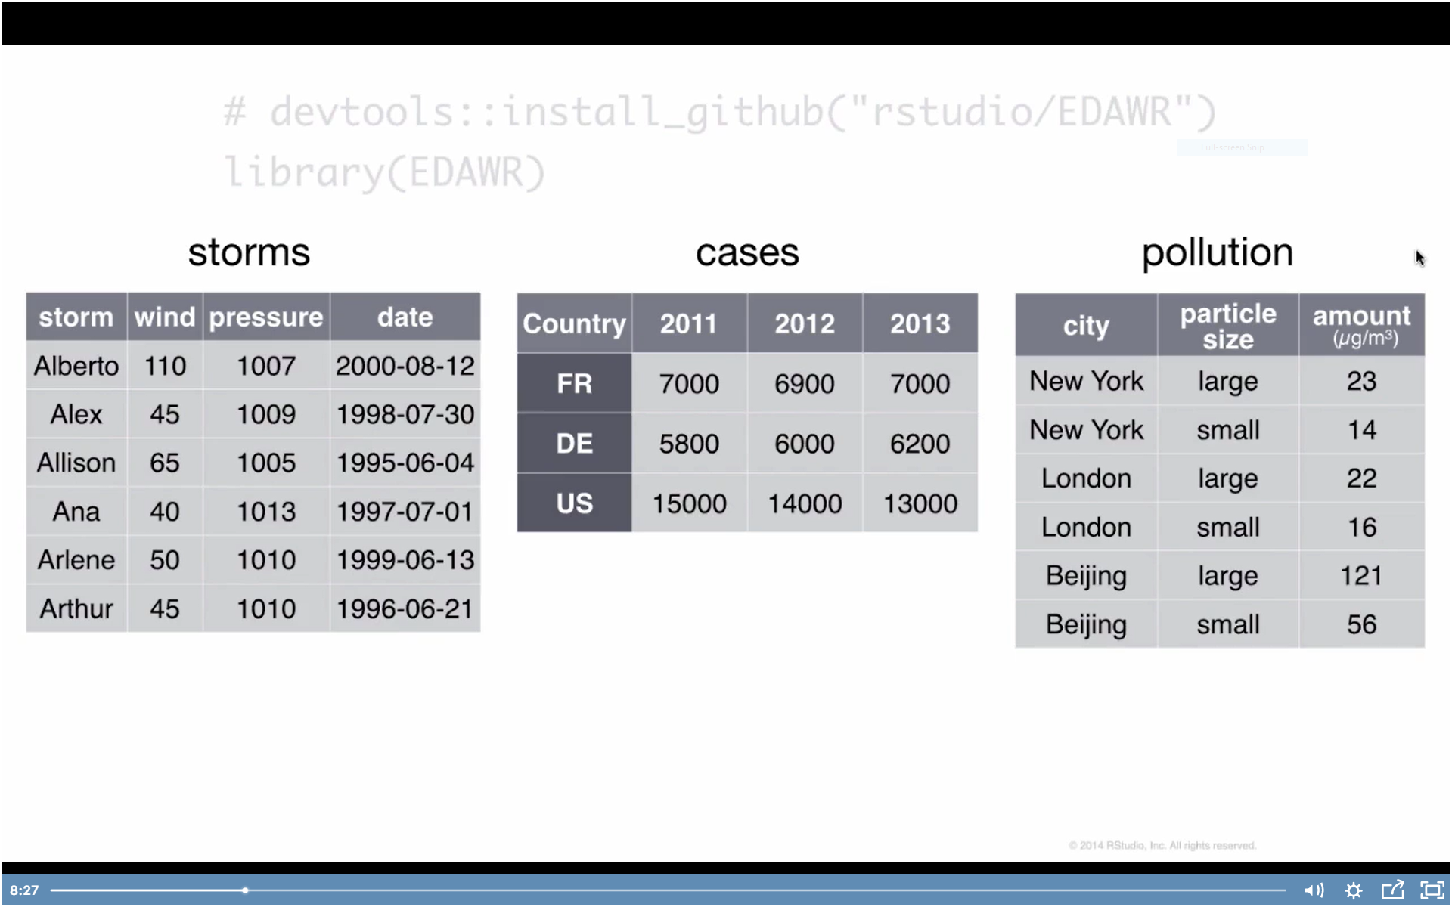
Table formatting

Slide 9
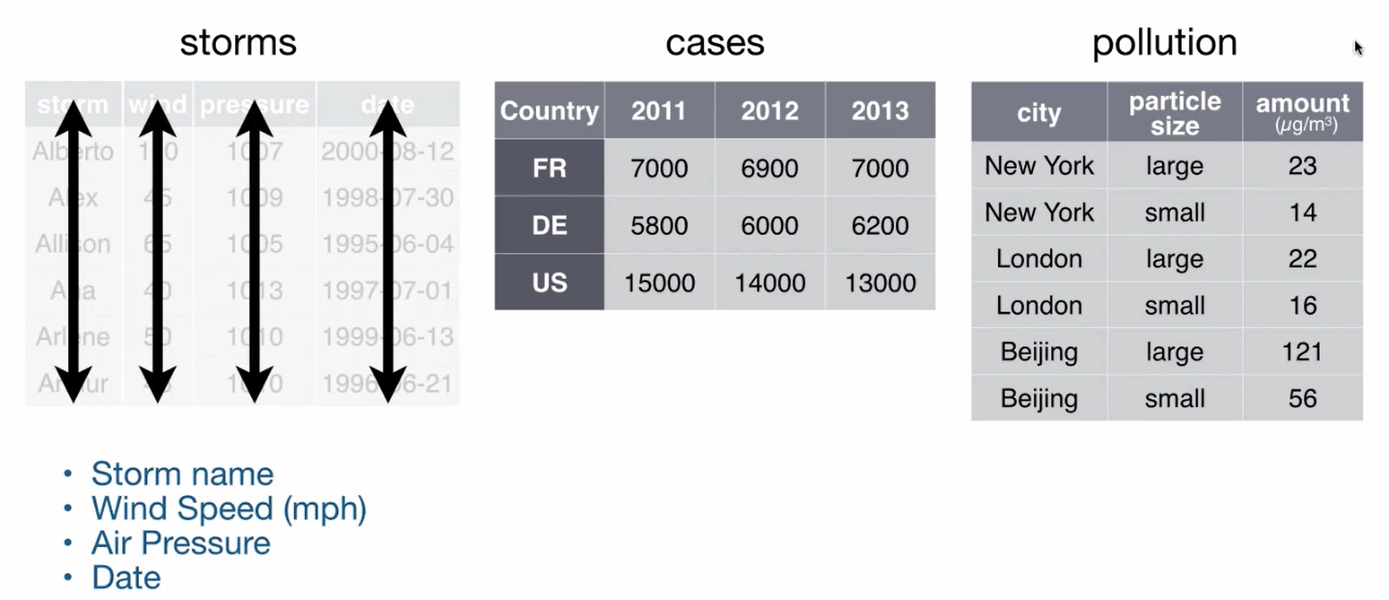
Table formatting

Slide 10
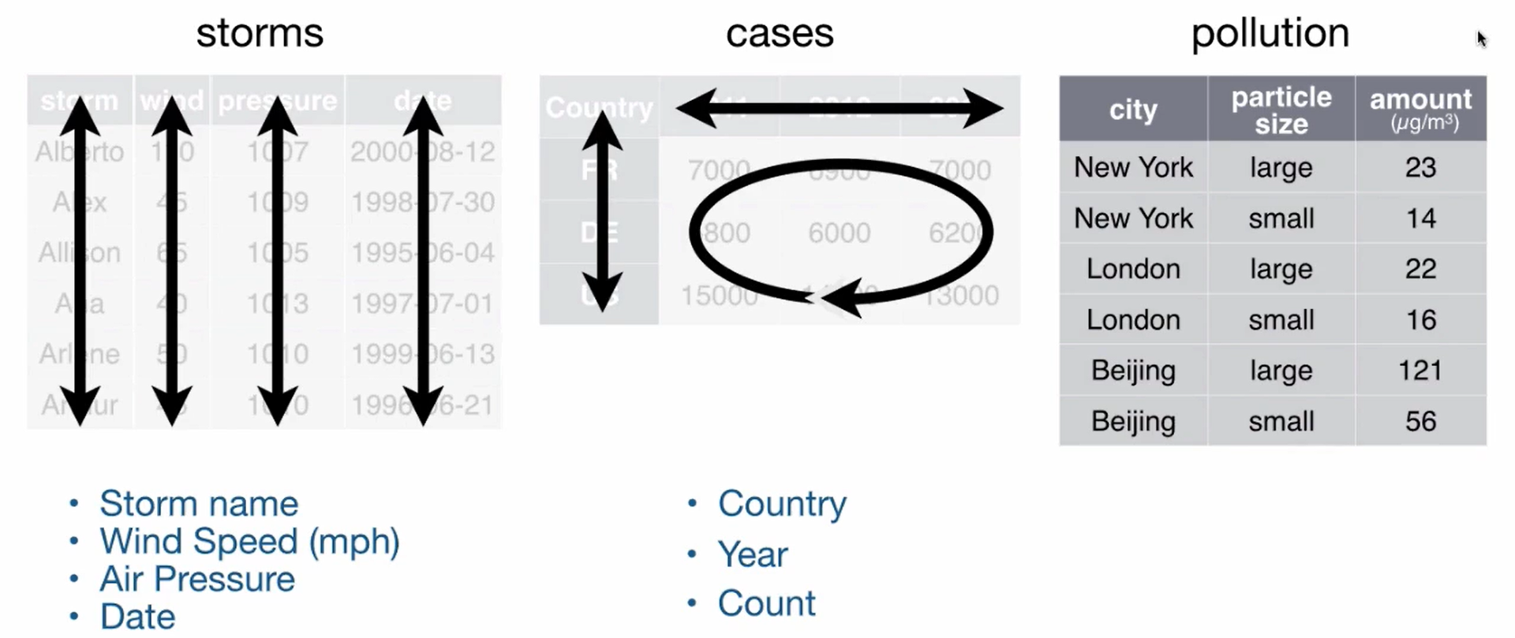
Table formatting

Slide 11
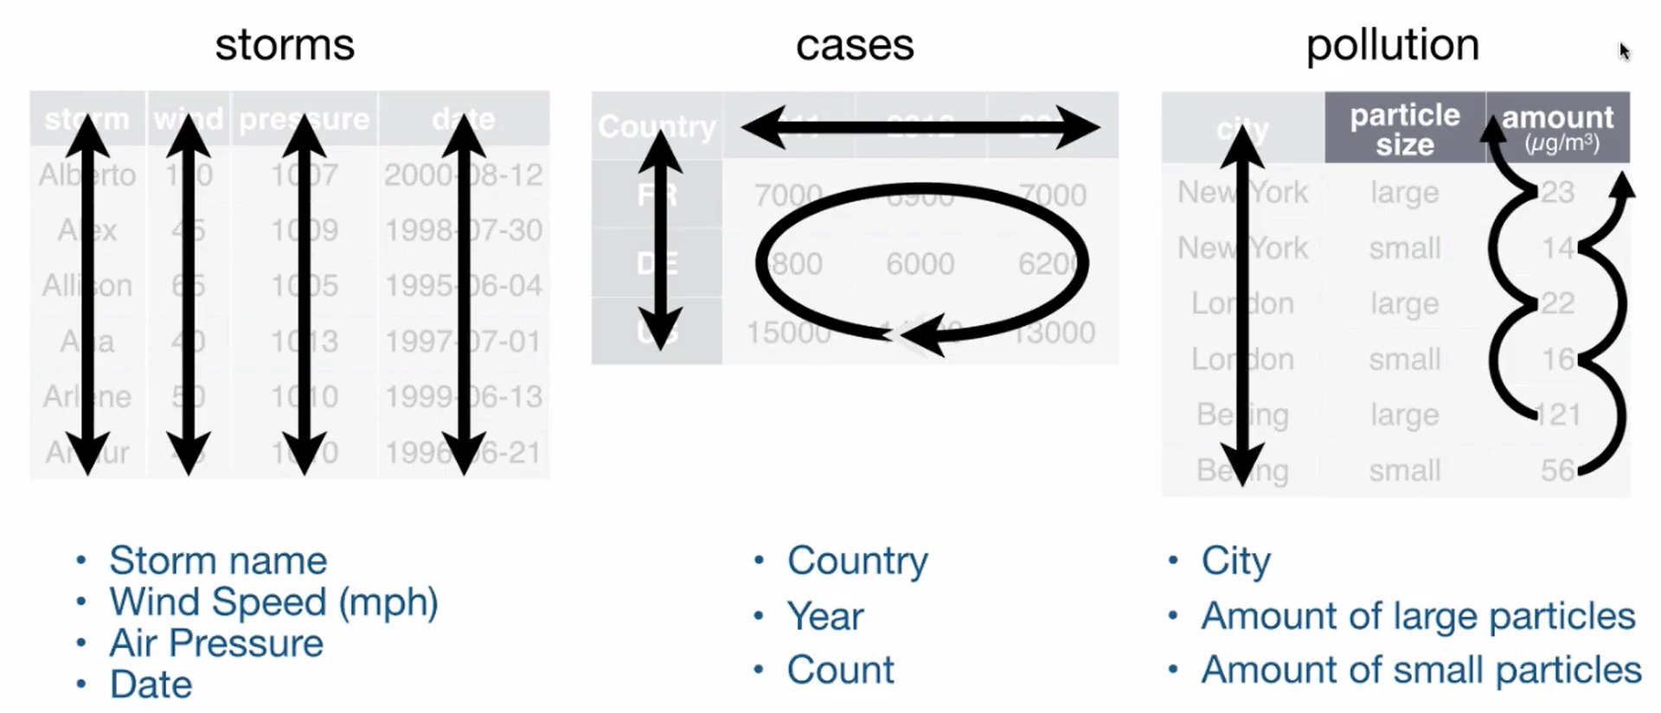
Table formatting

Slide 12
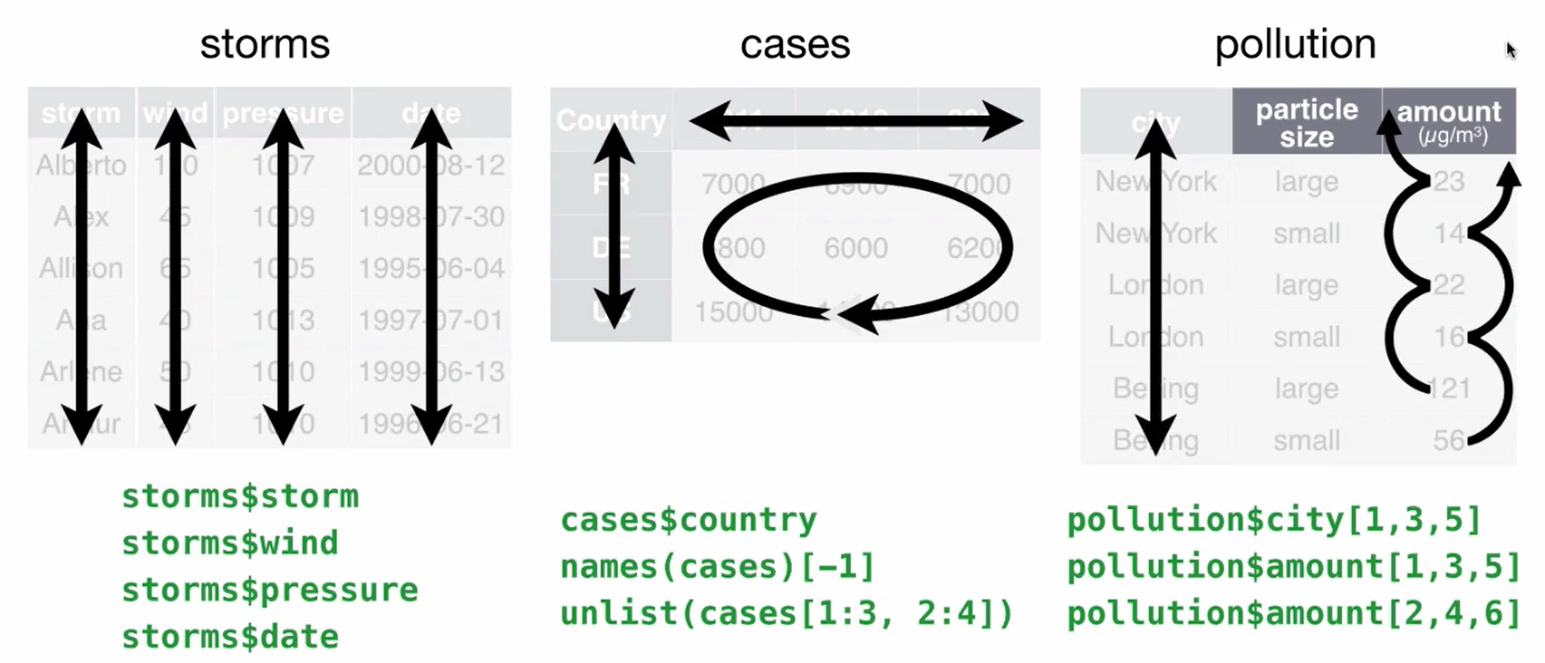
Table formatting

Slide 13
Three principles of tidy data
Each variable is saved in its own column
Each observation is saved in its own row
Each “type” of observation is stored in a single table (e.g. storms)

Slide 14
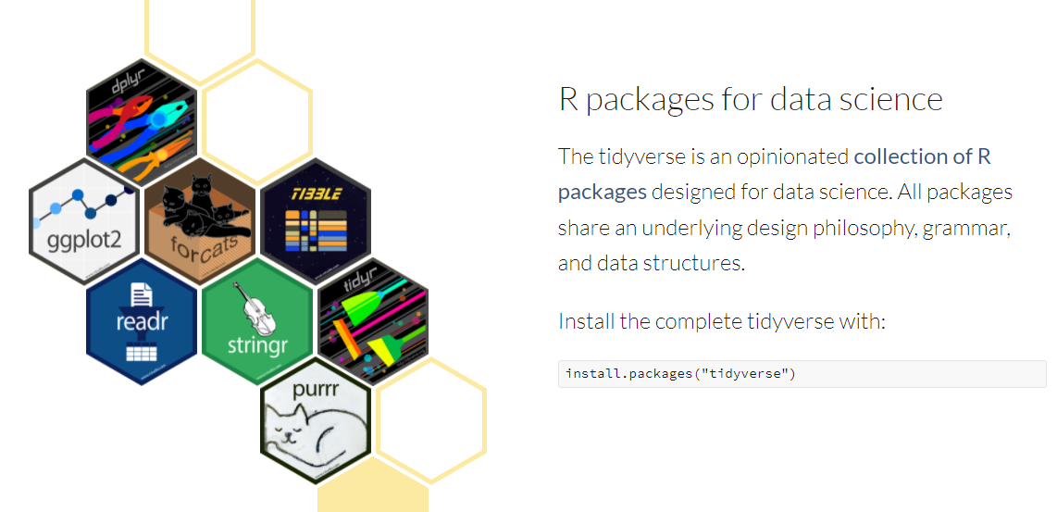
Enter the tidyverse
Consider criticisms of tidyverse

Slide 15
Tidyverse and beyond resources
RStudio cheat sheets including tidyverse packages
Good overview of data wrangling using tidyverse
Hadley Wickham’s R for Data Science

Slide 16
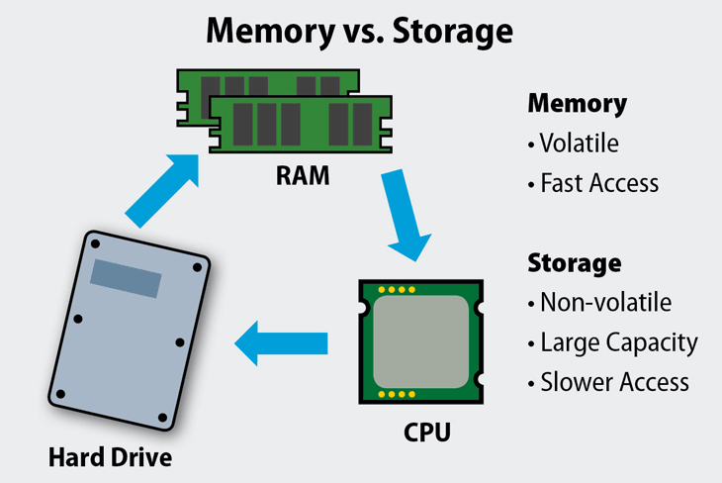
Computer memory and working with data
“Medium” data:
< 2 GB
“Large” data:
2-10 GB
“Big” data:
10+ GB

Slide 17
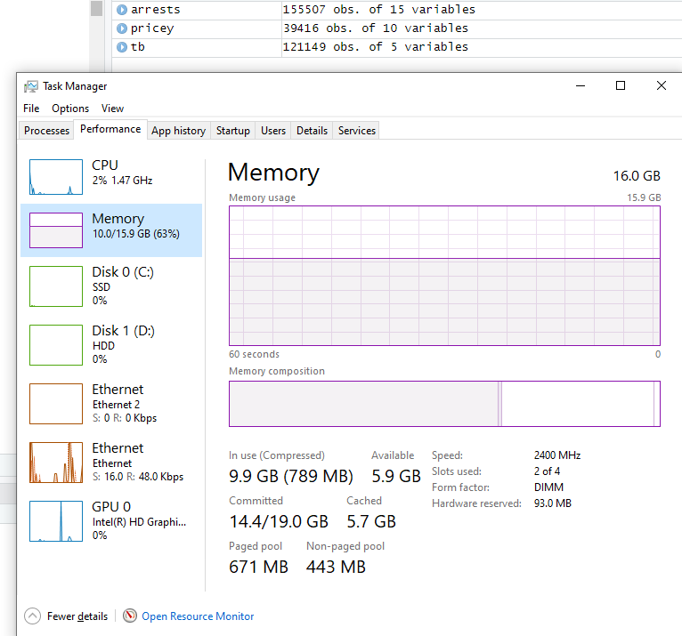
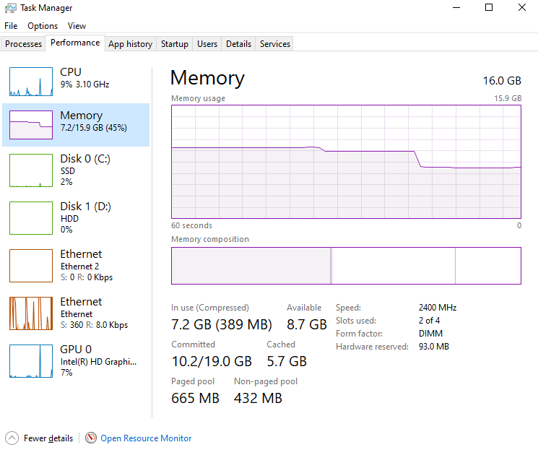
Computer memory
Google Chrome with
10 tabs open
Rstudio with
~300,000 rows of data

Slide 18
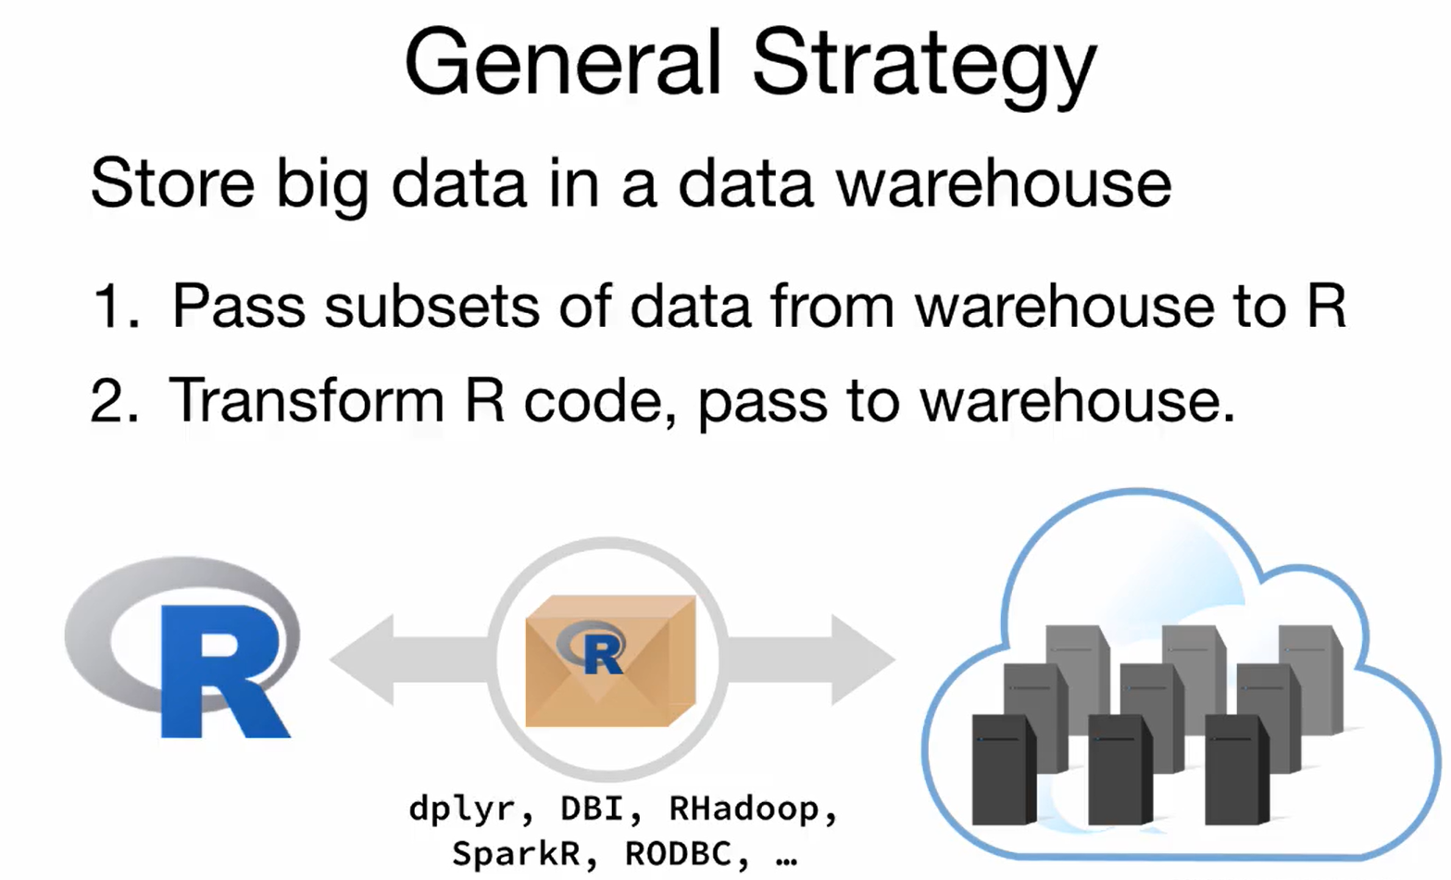
“Big” data

Slide 19
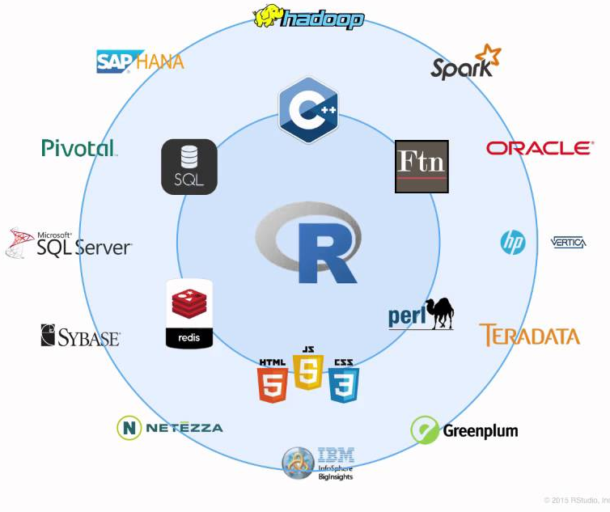
“Big” data

